Slide 1
Neoadjuvant therapy in breast cancer

Slide 4
Indications

Slide 6
Contraindication

Slide 7
Nomenclature

Slide 9
The following tests and procedure should be completed prior to NST

Slide 11
Before treatment starts or during treatment, the following issues should also be considered

Slide 13
Treatment Regimens

Slide 15
NETX can downstage breast tumours, converting an otherwise inoperable patient into an operable one or enabling BCS.
Downstaging rates vary, but up to 45%–50% of patients who would require an upfront mastectomy can be converted to BCS after NETX.
A recent meta-analysis demonstrated that aromatase inhibitors are superior to tamoxifen when used as NETX

Slide 16
Because a PCR after NETX is rare, that variable has not been routinely used as a predictor of long-term survival.
Immunohistochemical assessment of the Ki-67 index in core biopsies of tumour taken before, during, and at the end of NETX might be a more clinically useful and valid surrogate for outcome in patients with ER+ BCA.

Slide 24
Decision for Surgery

Slide 25
Surgical Planning – Breast Conserving Surgery

Slide 29
Surgical Planning – Mastectomy

Slide 30
Surgical Planning – Axillary Staging

Slide 35
Surgical Planning – Breast Reconstruction

Slide 38
Radiation therapy

Slide 39
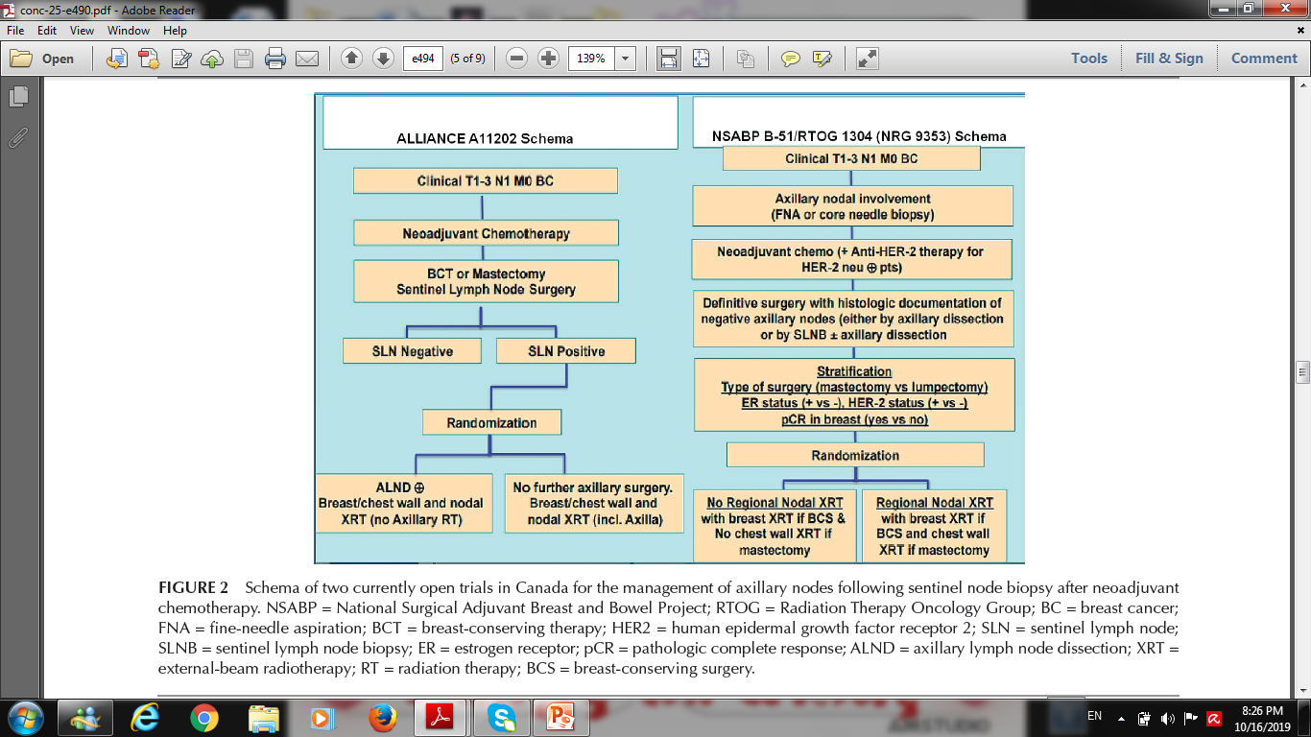

Slide 41
Thank you

